Slide 1
Online Depression Detection
PRESENTED BY
Ur name

Slide 2
Introduction To Project
The proliferations of internet and communication technologies, especially the online social networks have rejuvenated how people interact and communicate with each other electronically. The applications such as Facebook, Twitter, Instagram and alike not only host the written and multimedia contents but also oﬀer their users to express their feelings, emotions and sentiments about a topic, subject or an issue online. On one hand, this is great for users of social networking site to openly and freely contribute and respond to any topic online other hand, it creates opportunities for people working in the health sector to get insight of what might be hap- pening at mental state of someone who reacted to a topic in a speciﬁc manner. In order to provide such insight, machine learning techniques could potentially oﬀer some unique features that can assist in examining the unique patterns hidden in online communication and process them to reveal the mental state (such as ‘happiness’, ‘sad- ness’, ‘anger’, ‘anxiety’, depression) among social networks’ users.

Slide 3
Moreover, there is growing body of literature addressing the role of social networks on the structure of social relationships such as breakup relationship, mental illness (‘depression’, ‘anxiety’, ‘bipolar’ etc.), smoking and drinking relapse, sexual harassment and for suicide ideation

Slide 4
ABSTRACT
In this project we are detecting depression from users post, user can upload post in the form of text file, image file or audio file, this project can help peoples who are in depression by sending motivated messages to them. Now-a-days peoples are using online post services to interact with each other compare to human to human interaction. So by analysing users post this application can detect depression and send motivation messages to them. Administrator of this application will send motivation messages to all peoples who are in depression. To detect depression we are using SVM (support vector machine) algorithm which analyse users post and give result as negative or positive. If users express depression words in post then SVM detect it as a negative post else positive post. To implement this project we are using python Speech Recognition API which will read text from audio files and then SVM will analyse that text to detect depression,

Slide 5
user can also upload images via post and python Tesseract OCR (Optical Character Recognition) API can read text from uploaded image and then SVM will detect depression from that text, User can upload post in text file also.

Slide 6
EXISTING SYSTEM
detecting depression from users post, user can upload post in the form of text file, image file or audio file, this project can help peoples who are in depression by sending motivated messages to them. Now-a-days peoples are using online post services to interact with each other compare to human to human interaction.
we aim to analyze Facebook data to detect any factors that may reﬂect the depression of rel- evant Facebook’s users. Various machine learning techniques are employed for such purpose. Considering the key objective of this study, the following are subsequent research challenges addressed in paper.
As users express their feeling as a post or comments in the Face-book platform, sometimes their posts and comments refer to as emotional state such as ‘joy’, ‘sadness’, ‘fear’, ‘anger’, or ‘surprise’ [5, 6].

Slide 7
PROPOSED SYSTEM
To implement this project we are using python Speech Recognition API which will read text from audio files and then SVM will analyse that text to detect depression, user can also upload images via post and python Tesseract OCR (Optical Character Recognition) API can read text from uploaded image and then SVM will detect depression from that text, User can upload post in text file also.

Slide 8
ADVANTAGES OF PROPOSED SYSTEM:

Slide 9
MODULES
Admin Module:
Administrator will login to application using username as ‘admin’ andpassword ‘admin’. After login admin can view all registered users and all posts send by eachusers. Admin can send motivation messages to all depressed users. All positive and negativedepression users can also be seen in the form of graph.
User Module:
Users need to register with the application and then login to application to access various sub modules such as
Search Friends:
Using this module user can see all peoples register with the application
Upload Posts:
Using this module user can upload post in various formats such as text file,image or audio file. This application accepts only .WAV file format.

Slide 10
HARDWARE REQUIREMENTS
Operating System supported by
1. Windows 7
2. Windows XP
3 . Windows 8
Processor – Pentium IV or higher
RAM -- 256 MB
Space on Hard Disk -- Minimum 512 MB

Slide 11
SOFTWARE REQUIREMENTS
For developing the Application
1. Python
2. Django
3. Mysql
4. Mysqlclient
5. WampServer 2.4
Technologies and Languages used to Develop
-- Python

Slide 12
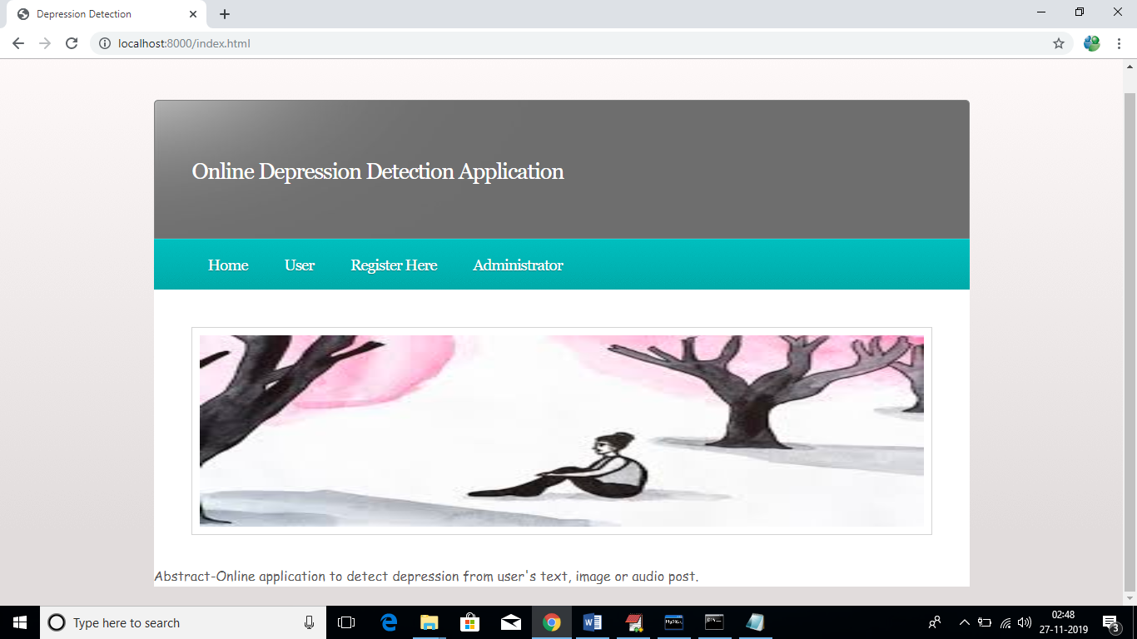
SCREEN SHOTS

Slide 13
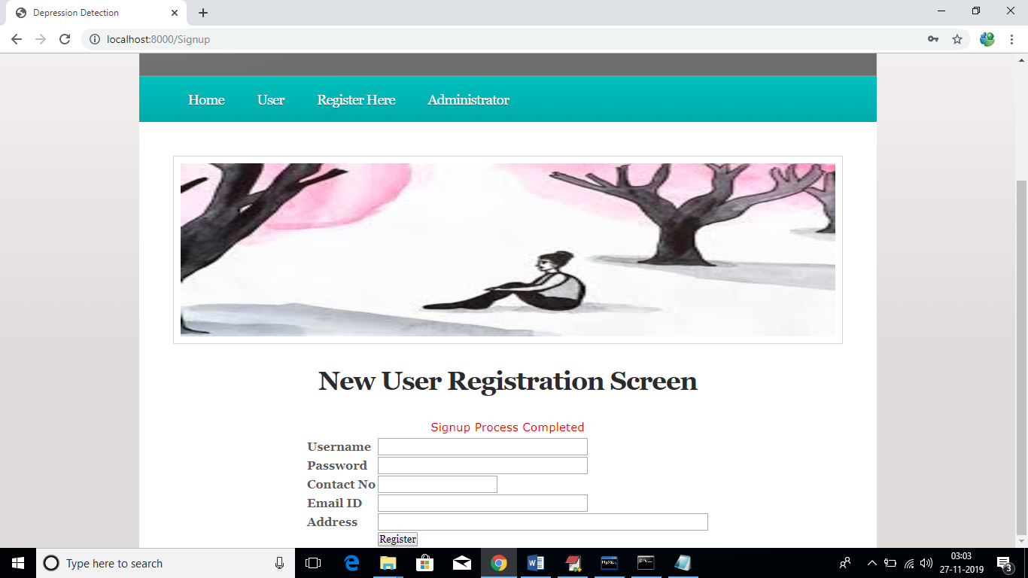

Slide 14
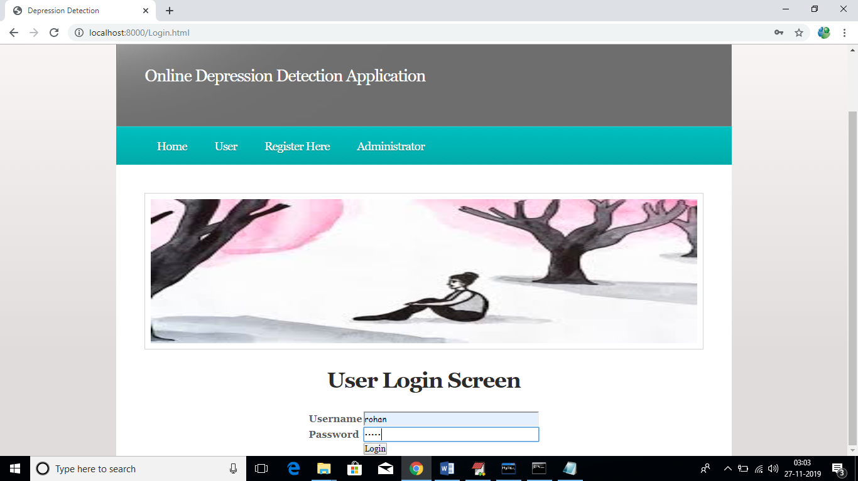

Slide 15
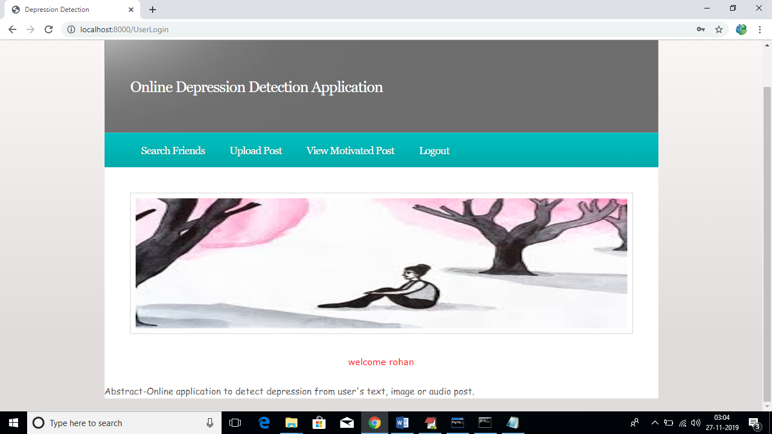

Slide 16
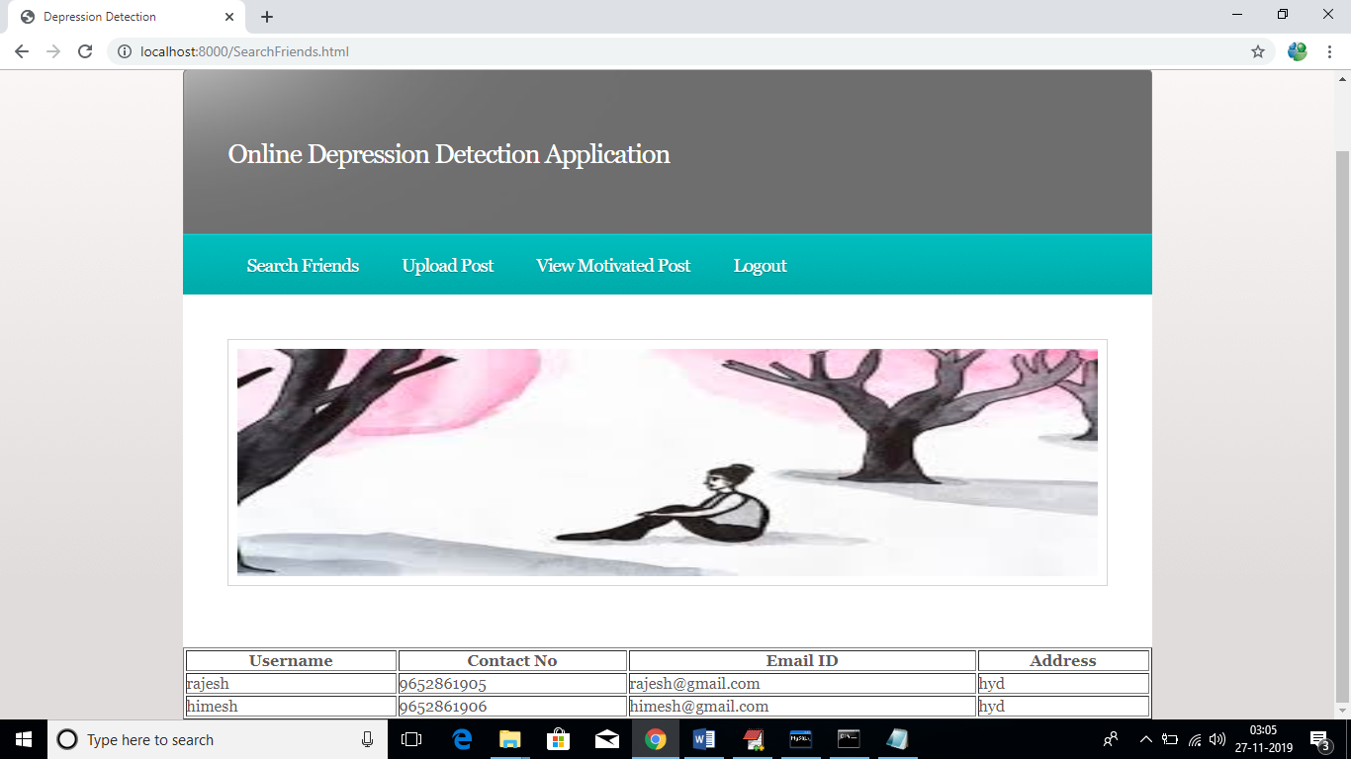

Slide 17
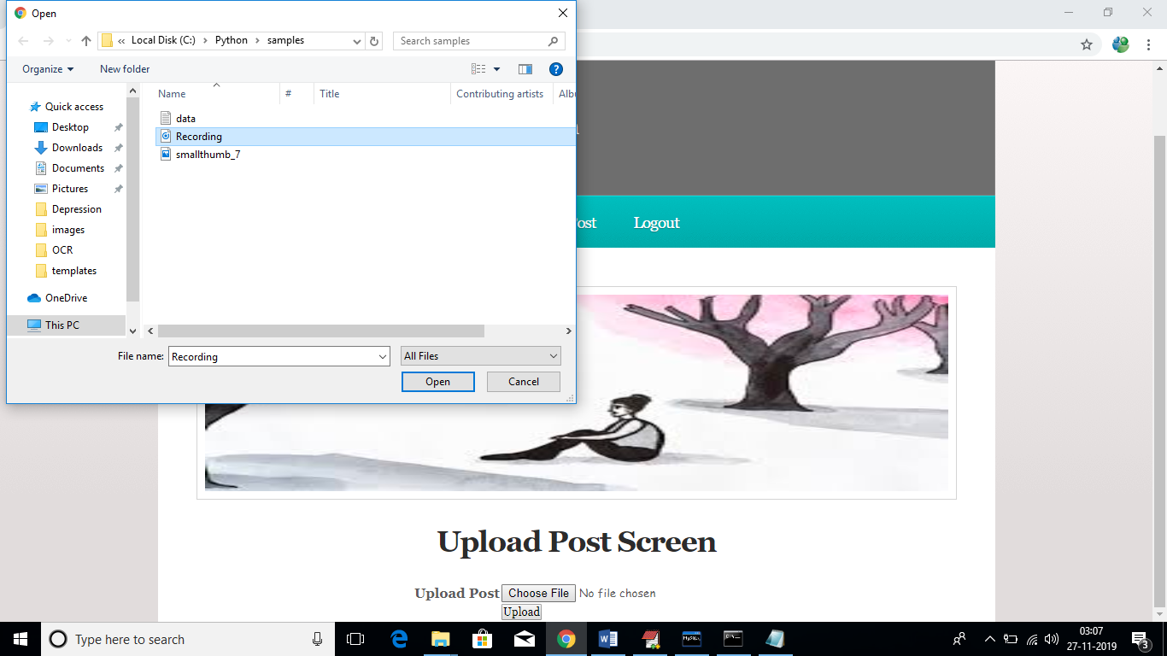

Slide 18


Slide 19
Conclusion
In this paper, we tried to identify the presence of depression in Reddit social media; and searched for affective performance increase solutions of depression detection. We characterized a closer connection between depression and a language usage by applying NLP and text classification techniques. We identified a lexicon of words more common among the depressed accounts. According to our findings, the language predictors of depression contained the words related to preoccupation with themselves, feelings of sadness, anxiety, anger, hostility or suicidal thoughts, with a greater emphasis on the present and future

Slide 20
Feature work
the best feature among the single feature sets is bigram; with SVM classifier it can detect depression with 80% accuracy and 0.79 F1 score. Considering LIWC and LDA features, LIWC outperformed topic models generated by LDA.

Slide 21
Thank you

